Slide 1

Classifying Histopathologic Glioblastoma Sub-regions with EfficientNet
Sanyukta Adap, Ujjwal Baid, Spyridon Bakas Research Analyst, Division of Computational Pathology, Department of Pathology and Laboratory Medicine, Indiana University School of Medicine
1

Slide 2
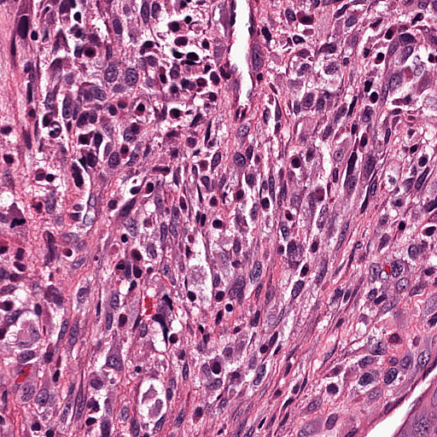
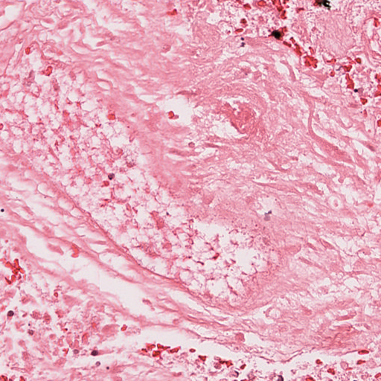
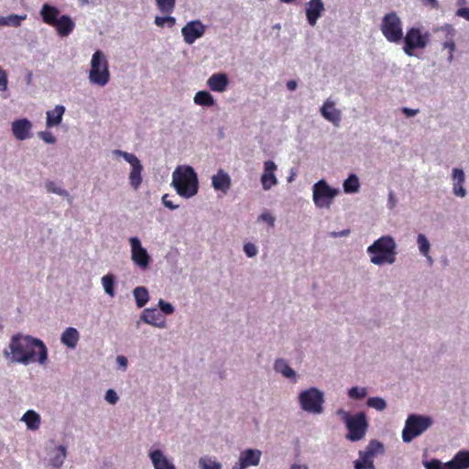
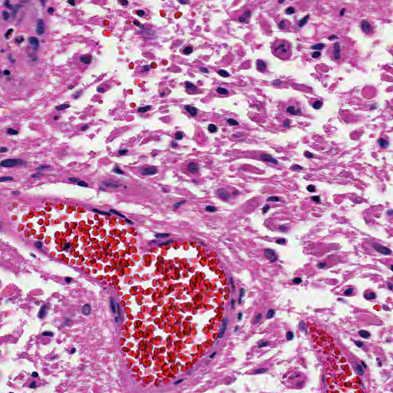
4-step approach
Prediction
Data/Input
(BraTS-Path: GBM patches)
0
Cellular Tumor
Preprocessing
Model Training
1
Pseudopolisading Necrosis
Deconvolution
5-fold
Cross Validation
Microvascular Proliferation
2
Augmentation
Scaling
+
Ensembling
3
Geographic Necrosis
4
Infiltration into cortex
5
Penetration into White Matter
2
Notes:
This study proposes a four-step approach in solving a classification problem with deep learning.
First, the dataset
undergoes a set of pre-processing steps to make the images compatible
for model training.
We feed the images to the model for training in a 5-fold cross-validation manner.
During inference, we ensemble the best model from each fold and
output the prediction based on the average output from all folds, combined. I will briefly go through each of these steps in this presentation and also discuss some findings at the end.

Slide 3

1. Data: GBM Patches
BraTS-Path Training Set
CT
PN
MP
NC
IC
WM
3
Notes:
We divided the brats training dataset into
five folds,
We did a stratified split to maintain the distribution of classes across the folds.
Then, images will pass through each step of the pipeline in mini-batches

Slide 4
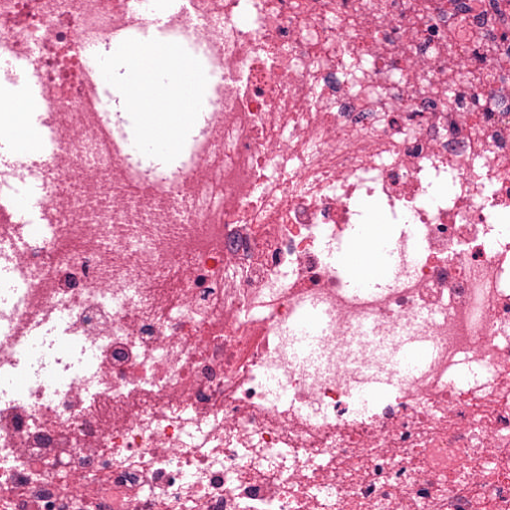
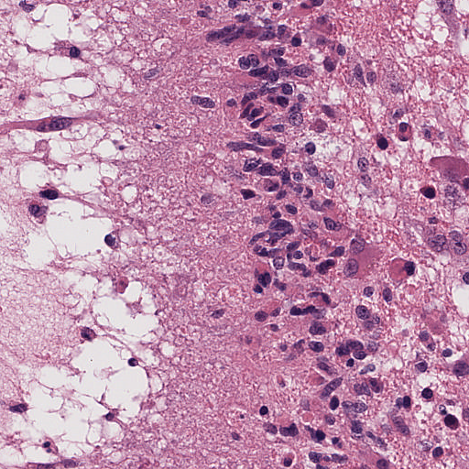
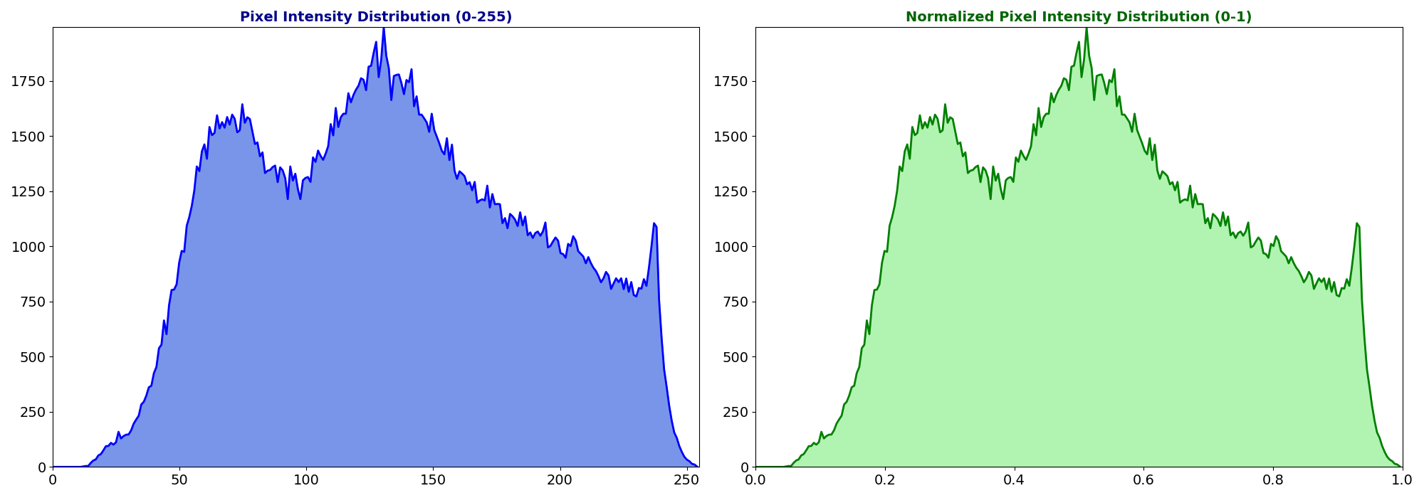
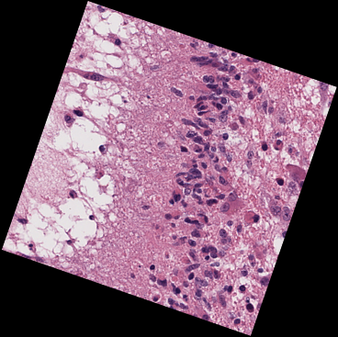
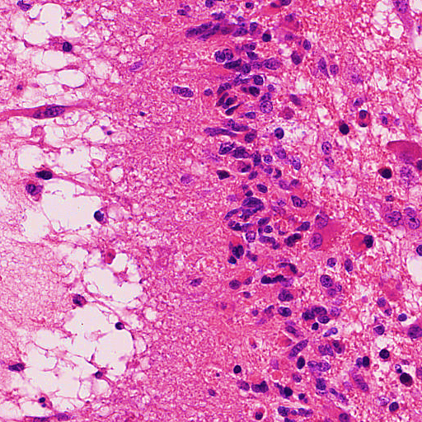
2. Preprocessing
Deconvolution
Augmentation
Scaling
Original
Original pixel intensities
Rotation
0
255
Vertical flip
Scaled pixel intensities
Horizontal flip
Color jitter
0.0
1.0
4
Notes:
Next, for preprocessing,
the images are first decoded.
Meaning, that the image will first be converted to numerical arrays with
3 channels, R G and B. Each pixel in the RGB image tensors encode the intensities of the colors red, green, and blue.
Next, the images are augmented to enhance the dataset’s variability by
implementing a series of transformations
These include random rotations,
random vertical flips
Random horizontal flips, as well as
Jittering the colors by random modifications to brightness and contrast. These augmentations generate diversity by creating different variations of each image, thus increasing the number of unique data points with every iteration through the dataset.
For the last step of transformations, the images are scaled by first calculating the mean and standard deviation for all the images in the mini-batch, and then normalizing the images by subtracting the mean and dividing it by the standard deviation, to get normalized/scaled values of pixel intensities.
Thus, the distribution of values remains the same, however, the range of pixel values change.

Slide 5
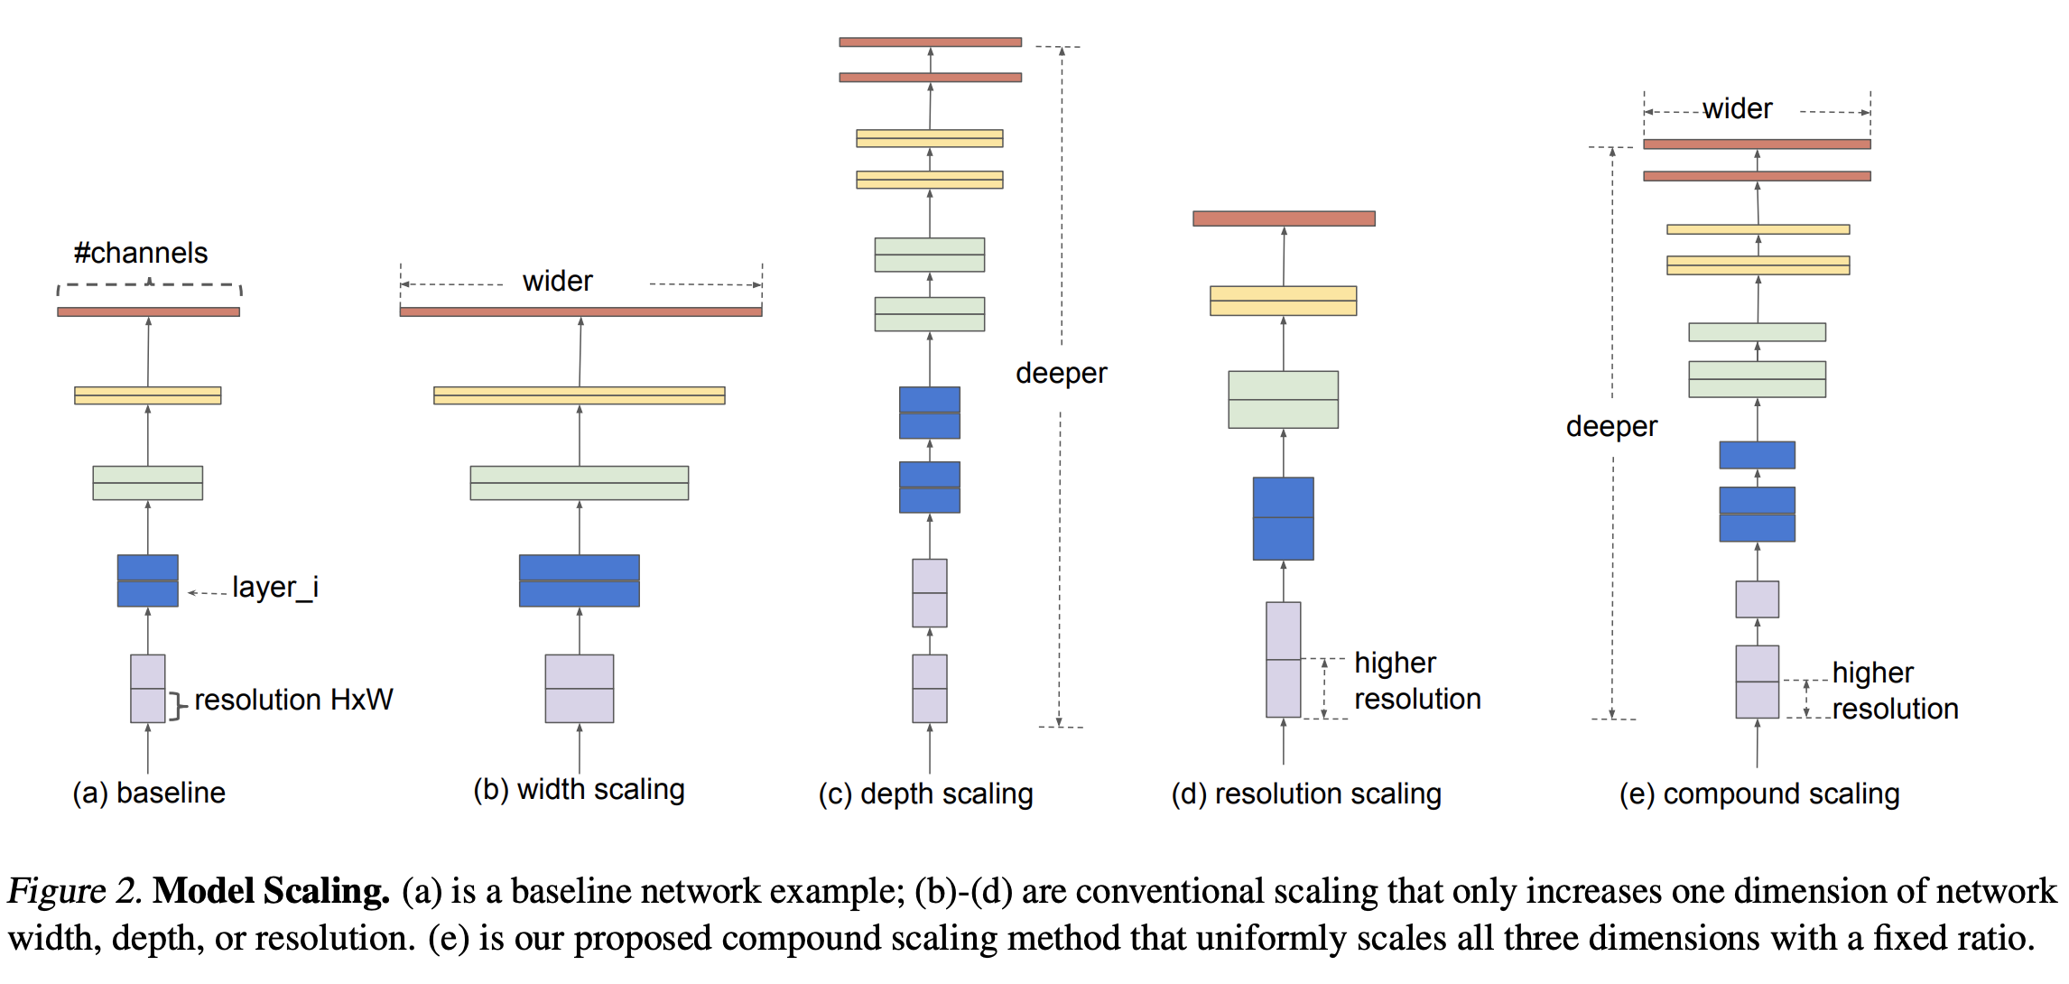
3. Model Training
EfficientNet (ENet) (Tan & Le, 2019)
4. Prediction
Fold #1
Fold #2
Fold #3
Fold #4
Fold #5
Model #1
TRAIN
TRAIN
TRAIN
TRAIN
VAL
Pred #1
Model #2
TRAIN
TRAIN
TRAIN
VAL
TRAIN
Pred #2
Prediction on unseen data
TRAIN
TRAIN
VAL
TRAIN
TRAIN
Ensemble
Model #3
Pred #3
(Average)
Model #4
TRAIN
VAL
TRAIN
TRAIN
TRAIN
Pred #4
Model #5
VAL
TRAIN
TRAIN
TRAIN
TRAIN
Pred #5
5
Notes:
For model training, our main focus was based off of
EfficientNets and its variants. EfficientNets are a range of models that have made model scaling systematic by balancing the depth (number of layers), width (number of channels), and input image resolution of CNN models using predefined scaling coefficients and constraints. The model ranges from B0 to B7 where B0 is a baseline model, and the variants B1 to B7 are its scaled-up versions. In this study, we used transfer learning to train ENet-B0 to B4 pre-trained on ImageNet to train them on the BraTS-Path training data.
We trained the EfficientNet models in a 5-fold cross validation manner as we can see in the figure to obtain 5 models.
For running the inference,
we ensembled the outputs obtained from each of the 5 models, by taking their average and then applying a softmax function over it.
The prediction obtained from Ensembling was considered as the final prediction of the test set images. This way, we combine the results from each “weak” model to form one “strong” model, that can classify the images much better than each of the individual models, also while avoiding systematic biases of the individual models.

Slide 6
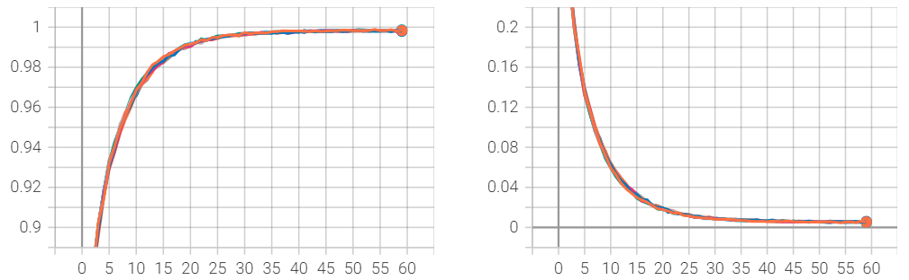
Results & Conclusion
Cross Validation: Training curves on top-2 models
Table 3. Cross Validation results on challenge validation data …….
Model | Checkpoint | Val F1 | Val MCC
ENet-B1 | 20 | 0.491 | 0.388
ENet-B1 | 25 | 0.509 | 0.401
ENet-B1 | 30 | 0.546 | 0.436
ENet-B1 | 35 | 0.535 | 0.427
ENet-B4 | 20 | 0.403 | 0.311
ENet-B4 | 25 | 0.438 | 0.337
ENet-B4 | 30 | 0.393 | 0.307
ENet-B4 | 35 | 0.390 | 0.301
Table 1. Initial model screening w/o cross validation
F1
Model | Val F1 | Val MCC
ENet-B0 | 0.288 | 0.242
ENet-B1 | 0.462 | 0.374
ENet-B2 | 0.345 | 0.262
ENet-B3 | 0.274 | 0.214
ENet-B4 | 0.43 | 0.336
Epoch No.
Table 4. Raking as per Validation phase
ENet-B1 Fold-1
ENet-B1 Fold-2
ENet-B1 Fold-3
ENet-B1 Fold-4
ENet-B1 Fold-5
ENet-B4 Fold-1
ENet-B4 Fold-2
ENet-B4 Fold-3
ENet-B4 Fold-4
ENet-B4 Fold-5
Rank | Participant/ Team | F1 | MCC
1 | @Rithik | 0.734 | 0.584
2 | devaratha | 0.734 | 0.584
3 | @aasandino | 0.68 | 0.516
4 | @MWod | 0.62 | 0.541
5 | IU-ComPath | 0.546 | 0.436
6 | SAIIP-LITTLEKANG | 0.455 | 0.307
7 | Ying-Weng-Team | 0.392 | 0.255
8 | @luiscarm9 | 0.162 | 0.158
Table 2. Hyperparameters used for inference
Hyperparameter | Value
Batch Size | 16
Number of Epochs | 60
Loss Function | Cross Entropy
Optimizer | Adam
Momentum | 0.0001
Learning Rate (LR) | 0.001
LR Scheduler | Exponential
LR Decay Rate | 0.9
Loss
ENet-B1 may generalize better to new data
ENet-B4 may be overfitting
Importance of model complexity and generalization
Epoch No.
6
Notes:
So, lets take a few steps back and look at the results from our experimentation.
Initially, we did some experimentation with the efficientnet models b0 to b4, and the following are results obtained on the challenge validation set.
Here, we can see that Efficientnet b1 and b4 were the 2 top performing models out of the 5. We chose these 2 models for the rest of our experimentation by tweaking the hyperparameters to find the best combination.
Then, we trained b1 and b4 models in a 5-fold cross-validation manner with the hyperparameters shown in the table. The performance of both the models across all folds during the complete training was almost identical. Specifically, the training curves relative to both the F1 and loss for all 5 folds are overlapping as we can see in the figure here.
Thus, for inference, we ran all 5-fold models and used outputs from these at epochs 20, 25, 30 and 35 and ensembled their output to for prediction on the validation set provided by the challenge.
The results are shown here in table 3.
We can see that the efficientnet b1 had the highest f1 as well as MCC as compared to others.
During the validation phase of the challenge, our team was rank 5
This could imply that simpler models like ENet-B1 may generalize better to new data, when compared to more complex models, which can overfit on the training set. It also highlights the need to balance model complexity with generalization, especially in medical applications.

